Slide 1
Modelling Life Expectancy
Descriptive Analysis by building a
Linear Regression Model based on social, health & economical factors
19.11.2021 | Emma | Hong | Raphael

Slide 2
What makes us live longer?

Slide 3
Dataset
WHO
Collected by
UN
193 countries
Year 2000 – 2015
2938 records
22 variables
kaggle
Distributed by
.com¹
¹ https://www.kaggle.com/kumarajarshi/life-expectancy-who

Slide 4
Variables
Infant deaths
Under-5 deaths
mortality
Adult mortality
Health expenditure %
HIV / AIDS
GDP (per capita)
economical
BMI
social
schooling
Polio
Alcohol consumption
Immuni-
zation
Hepatitis B
Thinness age 1-19
Diphtheria
Population
Measles

Slide 5
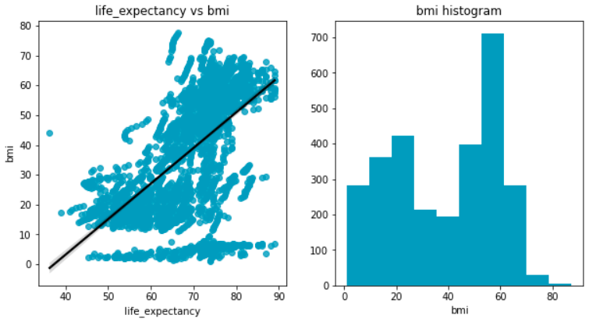
Datacleaning
Highly correlating - dropped
<5 deaths
Cleaned
With infant deaths (1)
GDP
Data replaced
with data
distributed
by worldbank.org²
Highly correlating - dropped
Adult
mortality
With life expectancy – our y
NaN
Dropped
Too dirty to clean - dropped
BMI
BMI of 60?
Is this a thing?
?
?
Normal distribution?
?
² big thx!
https://data.worldbank.org/indicator/NY.GDP.PCAP.CD

Slide 6
Model
Standard Scaler
Sklearn Library
Linear Regression
Ordinary Least Square (OLS)
Statsmodels Library
Initial Model
Improved Model
Dropping all variables with P < 0.05

Slide 7
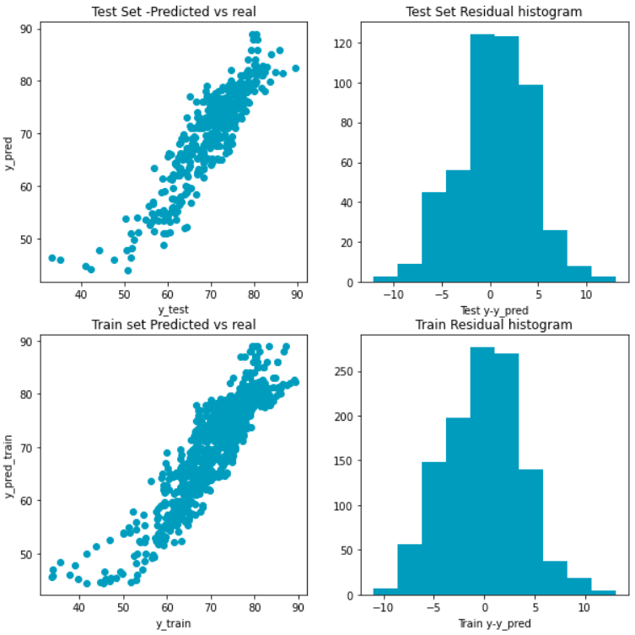
Model
R² = 0.78 |
8 variables

Slide 8
Importance
Variable

